Slide 1
d late comers !!!
Prepared by :-
Pinky Solanki
Hiren Sankadasariya
Rumit Jansari
Sushil Kumar
Vyom Wardhwana

Slide 2
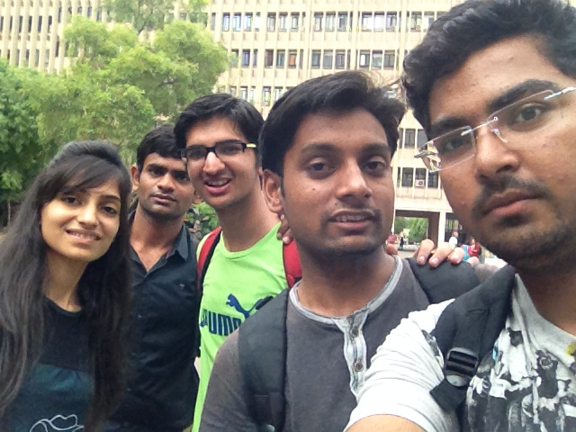

Slide 3
The WannaDO Ideas :
mySeat – a shoulder Bag with foldable legs used as a stool…
pasteURclicks – a website for photographers where they can post and publicize or even sell their photographs…
Mboard – a motorized scateboard for short distance travel charged by electricity produced from pizeoelectric material of the board…

Slide 4
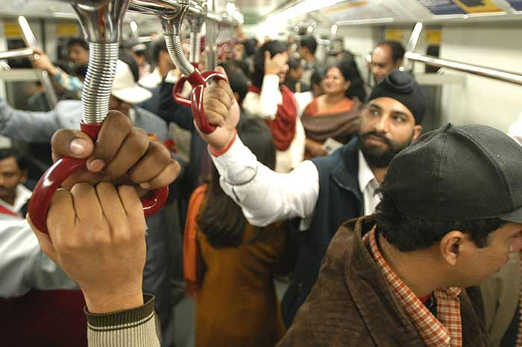
Pain Area
High ridership in public transport have led to overcrowding …

Slide 5
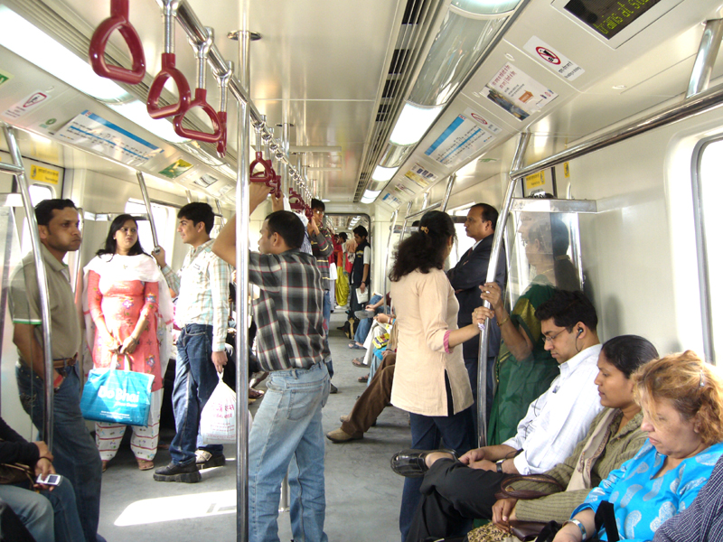
Problem Statement
Travelers need rest while travelling in public transports because unavailability of seats discomforts them.

Slide 6
Why “myseat” ?
IMPACT
Our product would certainly create buzz because:
Relief from standing while travelling…
Travelling with a foldable stool is quite clumsy so attachment of it with a bag makes it easy…
Mental frustration of paying for the ticket but not getting a seat would be reduced…

Slide 7
MARKET
People standing in metro and Local trains and buses .
People waiting for bus at bus stops.
People at food corners or canteen at peak hours.
People at railway stations.

Slide 8
COMPETITION
Shoulder bag companies
The portable chairs manufacturing companies .

Slide 9
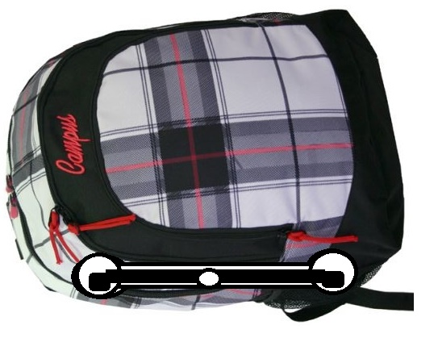
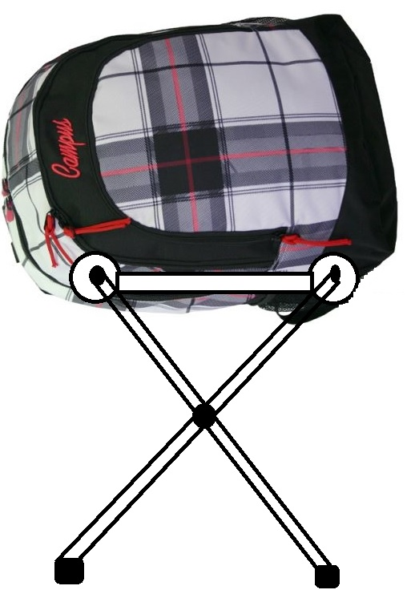
PRODUCT DESIGN

Slide 10
SCAMPER
Combination of a shoulder bag and a foldable stool

Slide 11



Six Thinkinhg Hats
Ergonomics / Human comfort is taken care of…
Low weight
No back obstacle like the trolley handle…
Controls frustration of people not getting a seat…
Easy handling…
Providing a foldable chair in shoulder bags…
Increasing the transportation facilities like no. of boggies etc..
Use of Light and strong materials like PVC in foldings..
Can be used even bus stops, crowded canteens or even for relaxing while walking…
Feeling relaxed even after travelling for a long time..
People will get 2 products at a
time…

Slide 12


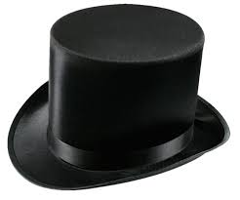
Possibility of breakage of legs of stool..
If the transportation facilities are improved , loss in market size would occur..
In Extreme overcrowding there might be no space even to open the stool..
Around 50% or more of total passengers don’t get seats on specific routes and in specific hours while travelling in delhi metro trains , mumbai locals (!!!!!), ahmedabad BRTS…
Etc..
So the conclusion can be deduced after looking at all the possible solutions is that mySeat can make a place for itself in the market…

Slide 13
Fish Bone Analysis
Cost of maintenance increases
Large number of people
Unavailability
of Seats
Same office timings for different organizations
Lesser number of seats

Slide 14
PRODUCT FEATURES
Compact and Comfortable
Economical
Optimized design
Easy to carry
Tailored to fit for all age groups.

Slide 15
Details & Costing of product
Material Used : hard plastic
Costing per bag:
Estimated cost of making the bag: Original cost of chair without chair + INR 200
Estimated selling price= Original selling price + INR 300
Estimated Profit price = Original profit + INR 100
Original cost of any bag= Ranges from Rs.500 to Rs.2500

Slide 16
Suggested tag lines
Have a seat.
Tailored to comfort.
Steams Your Style !!!
LE ke chalo apni………seat

Slide 17
Financial Help
We need an incubator for initial production of bags.
Transportation cost
Store outlets
Help needed for proper supply and reach.

Slide 18
Marketing Help
We need digital marketing for making it a huge buzz…….So TV and internet ADs,..
Newspaper Ads and live demonstrations by hired people of all age groups in the market…
Other marketing and publicity strategy

Slide 19
Strategic Know How
Initial Execution: Start in Mumbai and Delhi
After 6 months: Expanding to other 3 main cities.
After 2 years: 1o cities across India.
After 5 years: 20-25 cities across India.

Slide 20


Slide 21


